Slide 1

Computational Methods in
Power System Analysis
Lecture-10 Solution of Simultaneous Algebraic Equations And Load Flow Studies
By
Dr. Wazir Muhammad Laghari
Electrical Engineering Department
BUET, Khuzdar

Slide 2
Methods to Solve Solution of Simultaneous Algebraic Equations
Direct Method Iterative Method
Elimination Decomposition
Jacobi’s
Method
Gauss-Seidel
Method
Relaxation
Method
Gaussian Elimination Method
Gauss-Jordan Method
Crout’s Reduction Method
Cholesky’s Reduction Method

Slide 3
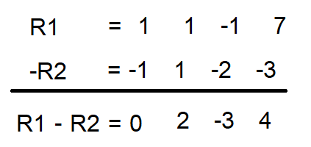
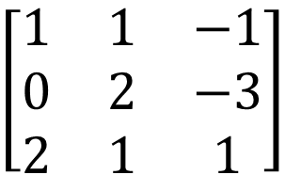
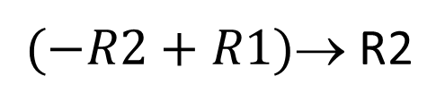
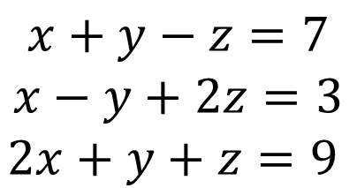
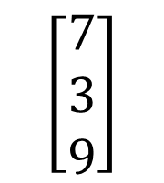
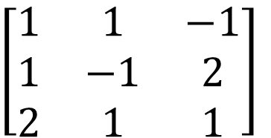
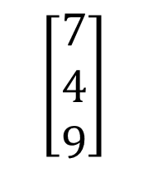
$$Q:Solve the Equations by Gauss Jordan Method$$
$$x+y−z=7$$
$$x−y+2z=3$$
$$2x+y+z=9$$
$$Convert equations into Matrix Form$$
$\left[\begin{matrix}1 & 1 & −1 \\ 1 & −1 & 2 \\ 2 & 1 & 1\end{matrix}\right]$
$$\left[\begin{matrix}7 \\ 3 \\ 9\end{matrix}\right]$$
$(−R2+R1)$ R2
$\left[\begin{matrix}1 & 1 & −1 \\ 0 & 2 & −3 \\ 2 & 1 & 1\end{matrix}\right]$
$$\left[\begin{matrix}7 \\ 4 \\ 9\end{matrix}\right]$$

Slide 4
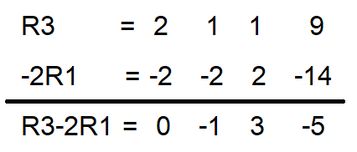
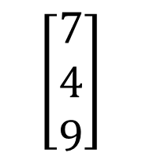
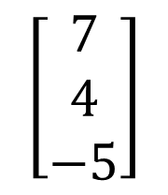
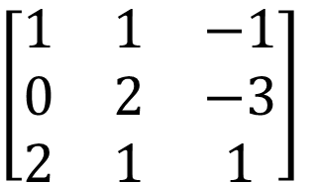
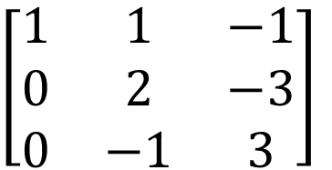
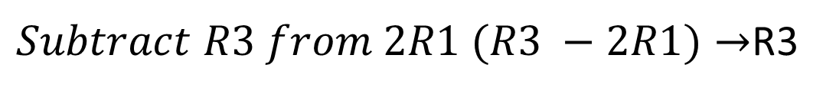
$\left[\begin{matrix}1 & 1 & −1 \\ 0 & 2 & −3 \\ 2 & 1 & 1\end{matrix}\right]$
$$\left[\begin{matrix}7 \\ 4 \\ 9\end{matrix}\right]$$
$Subtract R3 from 2R1 (R3 −2R1)→$R3
$\left[\begin{matrix}1 & 1 & −1 \\ 0 & 2 & −3 \\ 0 & −1 & 3\end{matrix}\right]$
$$\left[\begin{matrix}7 \\ 4 \\ −5\end{matrix}\right]$$

Slide 5
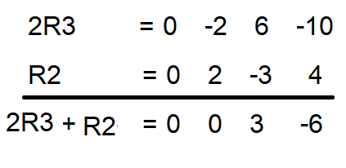
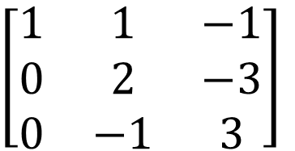
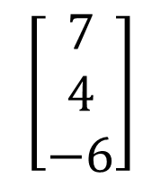
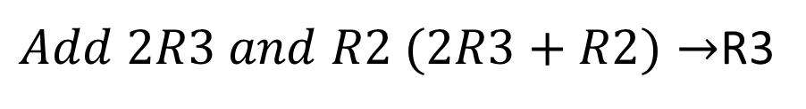
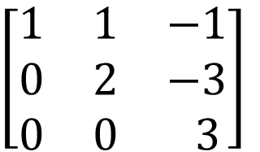
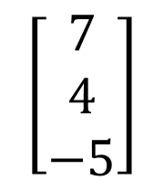
$\left[\begin{matrix}1 & 1 & −1 \\ 0 & 2 & −3 \\ 0 & −1 & 3\end{matrix}\right]$
$$\left[\begin{matrix}7 \\ 4 \\ −5\end{matrix}\right]$$
$Add 2R3 and R2 (2R3+R2)→$R3
$\left[\begin{matrix}1 & 1 & −1 \\ 0 & 2 & −3 \\ 0 & 0 & 3\end{matrix}\right]$
$$\left[\begin{matrix}7 \\ 4 \\ −6\end{matrix}\right]$$

Slide 6
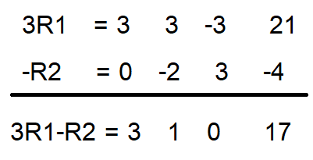
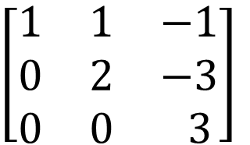
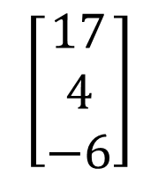
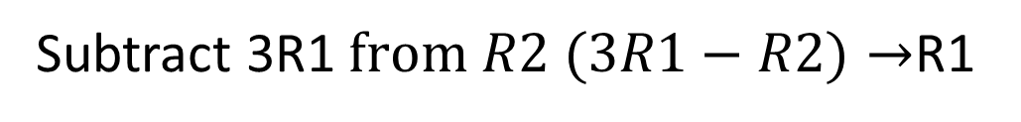
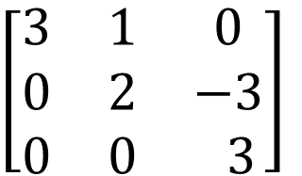
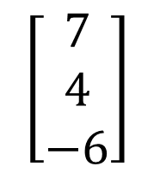
$\left[\begin{matrix}1 & 1 & −1 \\ 0 & 2 & −3 \\ 0 & 0 & 3\end{matrix}\right]$
$$\left[\begin{matrix}7 \\ 4 \\ −6\end{matrix}\right]$$
Subtract 3R1$from R2 (3R1−R2)→$R1
$\left[\begin{matrix}3 & 1 & 0 \\ 0 & 2 & −3 \\ 0 & 0 & 3\end{matrix}\right]$
$$\left[\begin{matrix}17 \\ 4 \\ −6\end{matrix}\right]$$

Slide 7
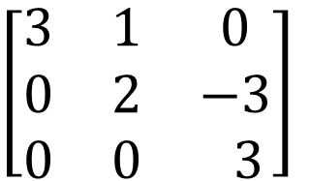
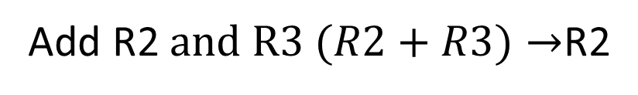
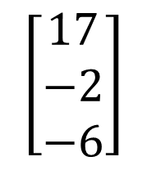
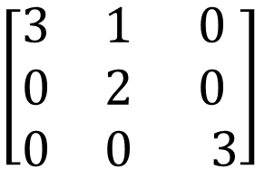
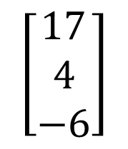
$\left[\begin{matrix}3 & 1 & 0 \\ 0 & 2 & −3 \\ 0 & 0 & 3\end{matrix}\right]$
$$\left[\begin{matrix}17 \\ 4 \\ −6\end{matrix}\right]$$
Add R2$and R3 (R2+R3)→$R2
$\left[\begin{matrix}3 & 1 & 0 \\ 0 & 2 & 0 \\ 0 & 0 & 3\end{matrix}\right]$
$$\left[\begin{matrix}17 \\ −2 \\ −6\end{matrix}\right]$$

Slide 8
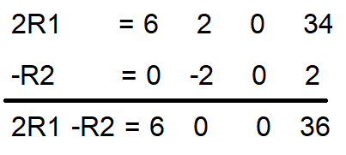
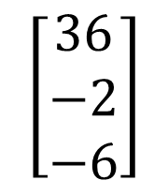
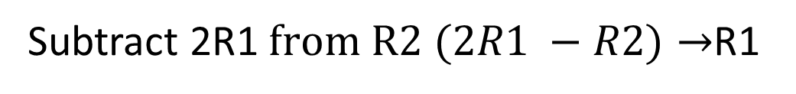
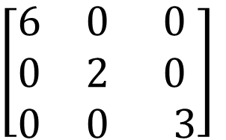
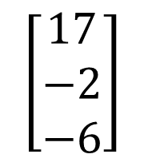
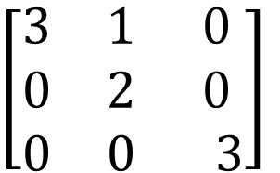
$\left[\begin{matrix}3 & 1 & 0 \\ 0 & 2 & 0 \\ 0 & 0 & 3\end{matrix}\right]$
$$\left[\begin{matrix}17 \\ −2 \\ −6\end{matrix}\right]$$
Subtract 2R1$from R2 (2R1 −R2)→$R1
$\left[\begin{matrix}6 & 0 & 0 \\ 0 & 2 & 0 \\ 0 & 0 & 3\end{matrix}\right]$
$$\left[\begin{matrix}36 \\ −2 \\ −6\end{matrix}\right]$$

Slide 9
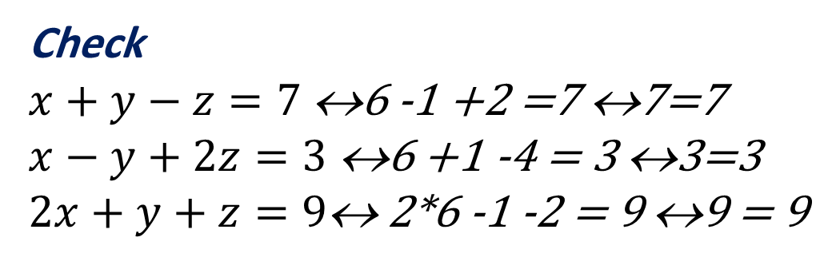
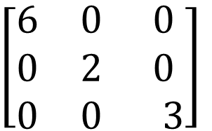

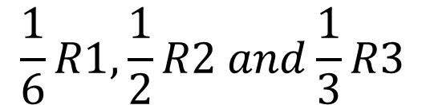
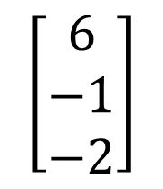
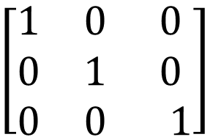
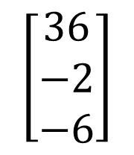
$\left[\begin{matrix}6 & 0 & 0 \\ 0 & 2 & 0 \\ 0 & 0 & 3\end{matrix}\right]$
$$\left[\begin{matrix}36 \\ −2 \\ −6\end{matrix}\right]$$
$$\frac{1}{6}R1,\frac{1}{2}R2 and\frac{1}{3}R3$$
Check
$x+y−z=7$ ↔6 -1 +2 =7 ↔7=7
$x−y+2z=3$ ↔6 +1 -4 = 3 ↔3=3
$2x+y+z=9\text{↔}$ 2*6 -1 -2 = 9 ↔9 = 9
$\left[\begin{matrix}1 & 0 & 0 \\ 0 & 1 & 0 \\ 0 & 0 & 1\end{matrix}\right]$
$$\left[\begin{matrix}6 \\ −1 \\ −2\end{matrix}\right]$$
$$x=6, y=−1 and z=−2$$

